Slide 1
第三章 立体及其交线
Chapter 3 Solids and Their Intersections
棱柱的投影Projection of Prism
棱锥的投影Projection of Pyramid
圆柱的投影Projection of Cylinder
圆锥的投影Projection of Cone
圆球的投影Projection of Sphere
平面与平面立体相交 Intersection of Plane and Polyhedral Solid(cutting)
平面与圆柱相交 Intersection of plane and Cylinder(cutting)
平面与圆锥相交 Intersection of plane and Cone(cutting)
平面与圆球相交 Intersection of plane and Sphere(cutting)
立体相交Intersection of slides

Slide 2

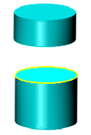
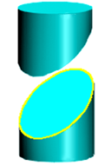
7.平面与圆柱相交 Intersection of plane and Cylinder
(圆柱体的截切 Cutting of cylinder)
截平面与圆柱面的截交线的形状取决于截平面与圆柱轴线的相对位置。The shape of the intersection depends the relative position of the cutting plane and the axis of cylinder.
P_{V}
P_{V}
P_{V}
P
P
P
垂直 Perpendicular
倾斜Inclined
平行
Parallel
圆Circle
两平行直线Two parallel lines
椭圆Ellipse

Slide 3

例1：求左视图 Construct the left view
椭圆
Ellipse
●
截交线的已知投影？
What is the given projection of the intersection?
●
●
●
●
●
●
●
截交线的侧面投影是什么形状？
What shape is the left view of the intersection?
(1) 找特殊点 Find the special points
●
●
(2) 补充中间点 Add middle points
(3) 光滑连接各点
Connect all points smoothly
(4) 分析轮廓素线的投影
Analyze the projection of the contour elements
●
●

Slide 4
例1：求左视图 Construct the left view

Slide 5
椭圆的长、短轴随截平面与圆柱轴线夹角的变化而改变。The major axis and minor axis of the ellipse varies with the angle between the cutting plane and axis of the cylinder.
45°
截平面与圆柱轴线成45°时……
When the angle is 45 °...

Slide 6
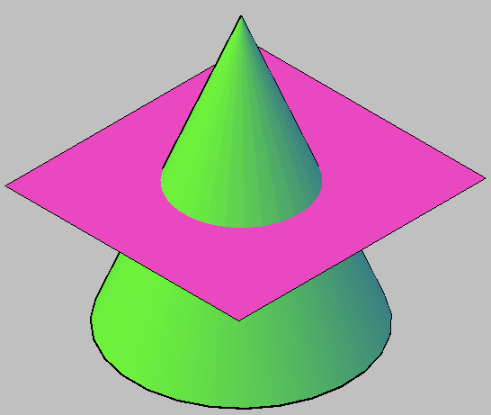
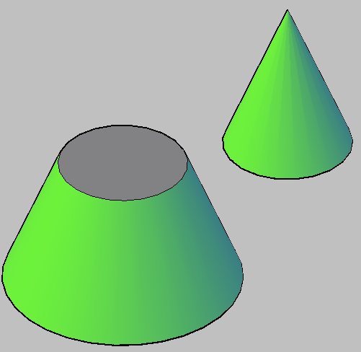

Slide 7
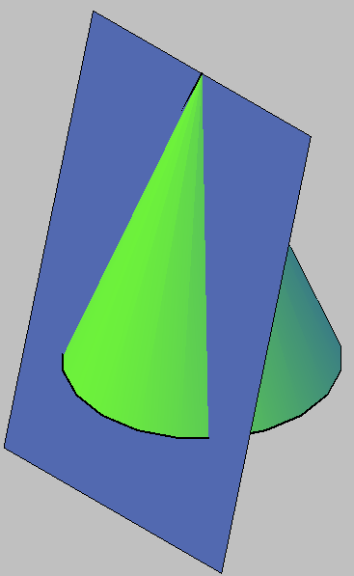
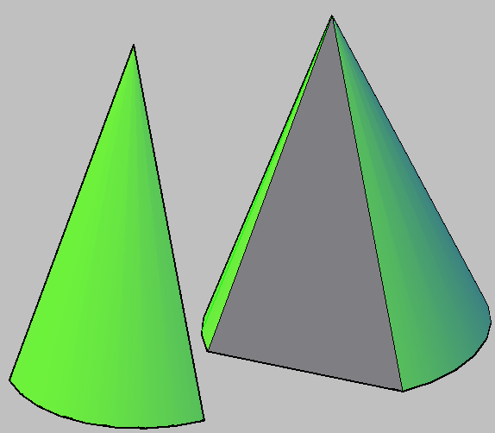

Slide 8
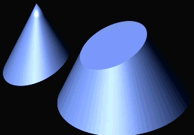
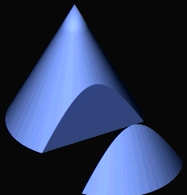

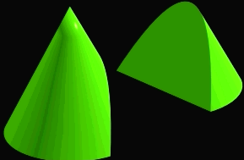

Slide 9


Slide 10
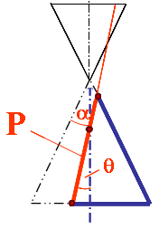
8.平面与圆锥相交 Intersection of plane and Cone
(圆锥体的截切 Cutting of cone)
P_{V}
根据截平面与圆锥轴线的相对位置不同，截交线有五种形状. Intersection may be one of five different shapes due to the relative position between the cutting plane and axis of the cone.
α
P_{V}
θ
θ
P_{V}
θ
α
α
P_{V}
P_{V}
θ=0
双曲线
Hyperbola
θ= 90°
过锥顶
Through the vertex
θ＞α
θ=α
圆
Circle
椭圆
Ellipse
抛物线
Parabola
两相交直线
Two intersecting lines
θ＜α
圆锥曲线Conic curves

Slide 11
例1: 圆锥被水平面截切，求截交线，并完成三视图。
Complete the three views of cone cut by Horizontal plane.
截交线的空间形状？
True shape of the intersection?
截交线的投影特性？
Projection of the intersection?

Slide 12

例2: 圆锥被正垂面截切，求截交线，并完成三视图。
Complete the three views of cone cut by V-perpendicular plane.
截交线的空间形状？
True shape of the intersection?
如何找椭圆另一根轴的端点？ How to locate the ends of the other axis of the ellipse?
截交线的投影特性？
Projection of the intersection?
中点
Mid Point
(1)找特殊点Find the special points
(2)补充中间点Add middle points
(3)光滑连接各点Connect all points smoothly
(4)分析轮廓线的投影
Analyze the projection of the contour elements

Slide 14
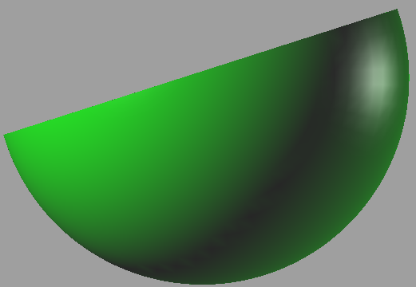
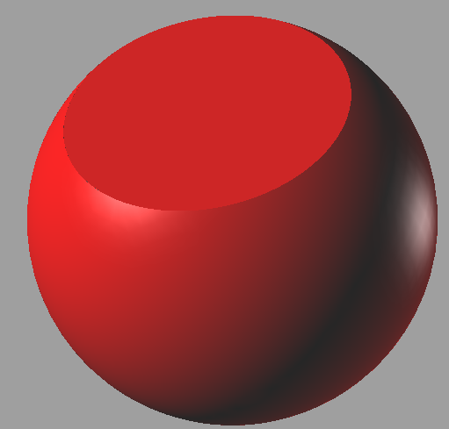

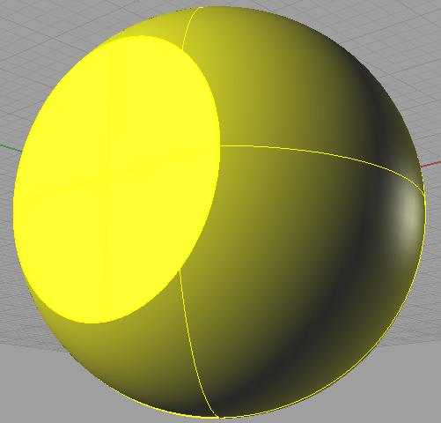
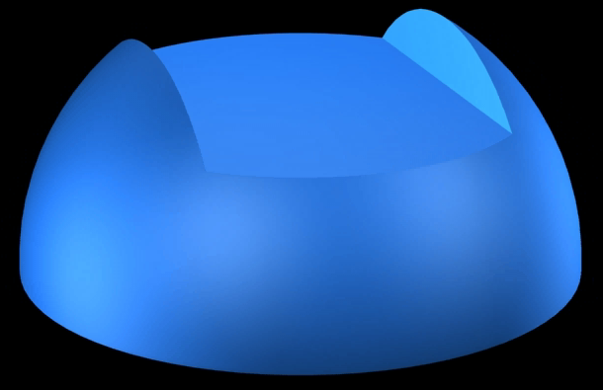
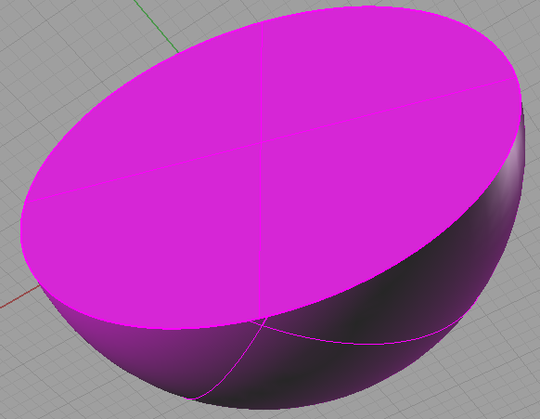
9. 球体的截切 Cutting of sphere
平面与圆球相交，截交线的形状都是圆，但根据截平面与投影面的相对位置不同，其截交线的投影可能为圆、椭圆或积聚成直线。 Intersections are all circles whatever planes intersect with a sphere. In projection , the circles can appear a circle (true shape), ellipse (similar) or line (concentrated) with the different positions of the cutting plane relative to the projection plane.

Slide 15
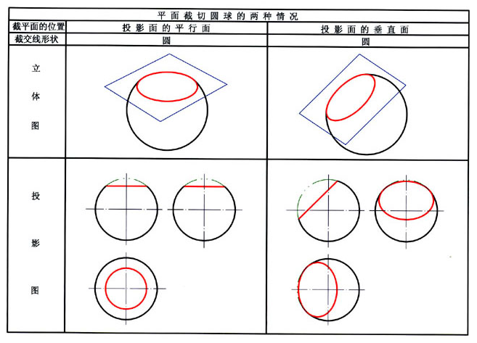

Slide 16
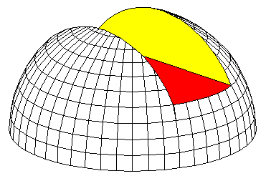
P15-4 ：求半球体截切后的俯视图和左视图。
Complete the top and left views of the cut hemisphere.
水平面截圆球的截交线的投影，在俯视图上为部分圆弧，在侧视图上积聚为直线。 The intersection of the horizontal plane cutting the sphere appears as arcs on top view and lines on left view.
两个侧平面截圆球的截交线的投影，在侧视图上为部分圆弧，在俯视图上积聚为直线。
The intersections of two W-planes cutting the sphere are projected as arcs on left view and lines on top view.

Slide 17
例1：求半球体截切后的俯视图和左视图。
Complete the top and left views of the cut hemisphere.

Slide 18
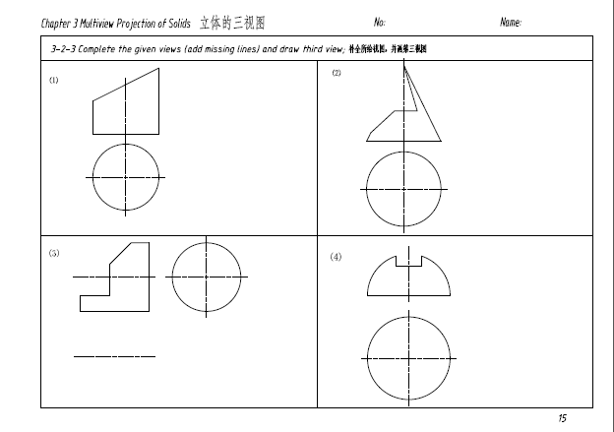
Homework2- P15(1,2,4), P11

Slide 19

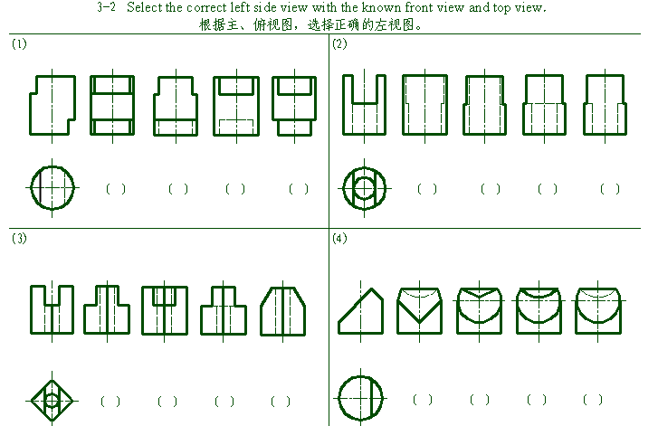
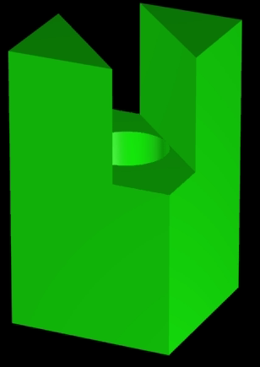
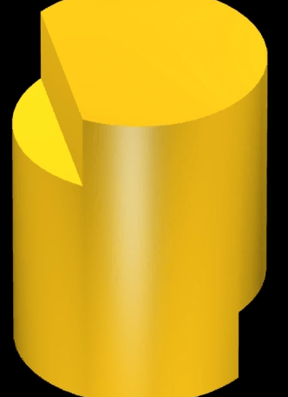
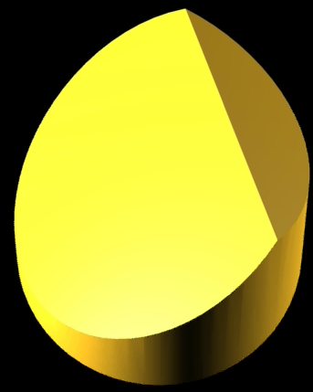
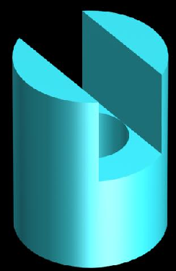

CLASS PRACTICE
1
2
3
4
1
2
3
4
1
2
3
4
1
2
3
4

Slide 20
例2：求左视图 .
同一立体被多个平面截切，要逐个截平面进行截交线的分析和作图。
(1) 空间及投影分析
●
截平面与体的相对位置?
截平面与投影面的相对位置?
●
(2) 求截交线
(3) 分析圆柱体轮廓素线的投影

Slide 21
例2：求左视图 .

Slide 22
例3：求左视图Construct the left view.
●
●

Slide 23
例3：求左视图Construct the left view.

Slide 24
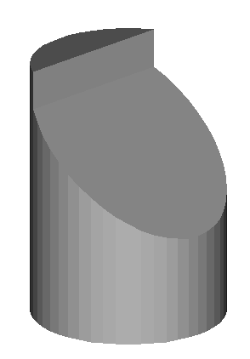
例5：求左视图
例4：求左视图
虚实分界点
Switch point of visibility

